Slide 1
Driver Drowsiness Project
Junzhe Zhang

Slide 2
Purpose
1. The goal of this project is to classify the drowsy driver by using the different features such as head position, eye position, and the eye open percentage.
3. To do the classification, the level of driver drowsiness should be defined. **Based on the Drowsy Testing Participant Info**, I defined 3 or less are not drowsy but 4 or more are drowsy. However, the threshold of drowsiness can be tuned by clustering method or cross-validation result (try different threshold into the same classification model and check the metrics).
2. This is a binary classification problem. I would like to build a baseline model and a machine learning model to solve this problem.
4. This problem needs some feature engineering and data cleaning before building the classification model. The feature engineering needs to capture the dynamic features based on the timestamp and frame.

Slide 3
Steps
0. Define the problem and understand the data (need to read some papers to understand the insight)
1. data integration and data exploration (starts from the small dataset)
2. data cleaning and feature engineering (dynamic feature)
3. build a simple model
4. build a complicated model
5. model validation
6. upgrade the model (try to solve the threshold of drowsiness) and implement the model

Slide 4
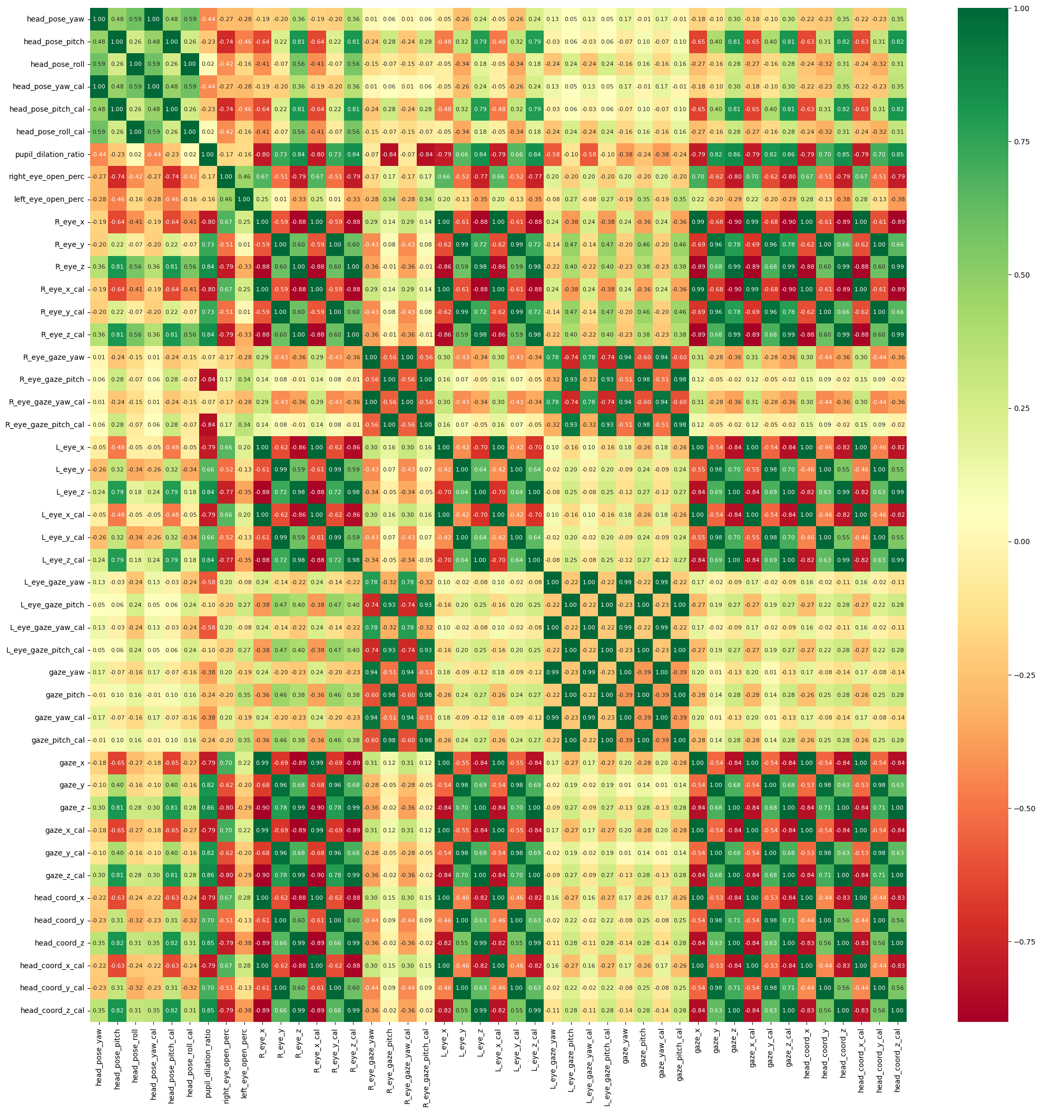
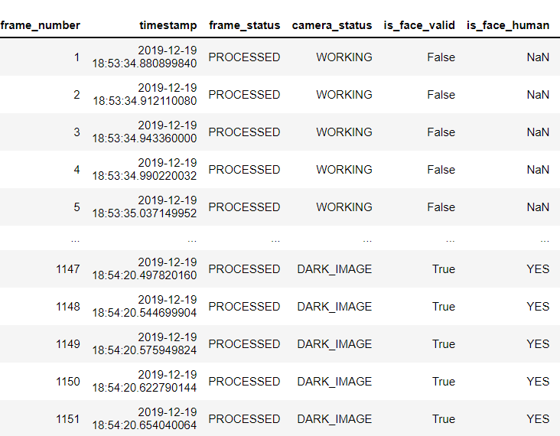
Data Exploration

Slide 5
Model and Evaluation
Model:
Baseline model: Logistic regression with all features
Random forest classification
Logistic regression with 2 most importance features
Evaluation:
70% training and 30% testing
Metrics: confusion matrix, recall, miss rate, roc score, and roc curve
Results:
Logistic regression with all features has 0.97 total accuracy with 0.97 recall and 0.067 miss rate
Logistic regression with 2 important features has 0.98 total accuracy with 0.95 recall (miss) and 0.033 miss rate
Random forest classification has 0.98 total accuracy with 0.97 recall (miss) and 0.033 miss rate

Slide 6
Assumptions and Suggestions
Assumptions:
1. the sampling considers the differences of human being such as age, race, gender, healthy condition, education level, job types
2. the sampling has enough samples in different condition such as day/night, season, weather condition
3. the sampling is stratified, which means each group has the similar amount of samples
4. the experiment is long enough to collect the driver drowsiness
5. the label of alert and drowsy is correct based on the KSS
Suggestions:
1. the physiological data may be needed for this study, which could improve the model performance
2. the number of wink and mouth open could be recorded during a time period
3. the difference behavior of drowsiness and inattentiveness should be considered

